Slide 1
WINDOWS FUNDEMENTALS

Slide 2
INTRODUCTION TO OPERATING SYSTEM

Slide 3
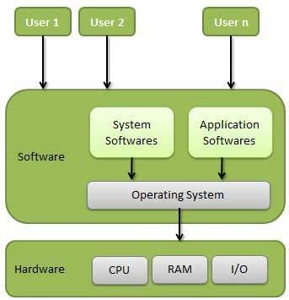
WHAT IS OPERATING SYSTEM?
An operating system, or "OS," is software that communicates with the hardware and allows other programs to run. It is comprised of system software, or the fundamental files your computer needs to bootup and function.

Slide 4

Operating systems
Windows
Linux

Slide 5
Types of operating system
There are Mainly 4 Types of operating systems
Time-sharing operating systems
Network operating System
Distributed operating System
Real Time operating System

Slide 6
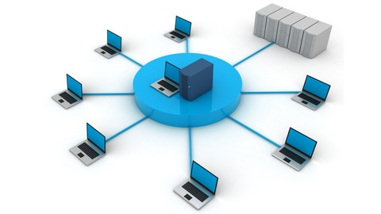
Time-sharing operating systems
Time-sharing is a technique which enables many people, located
various terminals,to use a particular computer system at the same time. Time-sharing or multitasking is a logical extension of multiprogramming.

Slide 7
NETWORK OPERATING SYSTEM
A specialized operating system for a network device such as a router, switch or firewall.
An operating system oriented to computer networking, to allow shared file and printer access among multiple computers in a network, to enable the sharing of data, users, groups, security, applications, and other networking functions, typically over a local area network (LAN), or private network . This sense is now largely historical, as common operating systems generally now have such features included.

Slide 8
There are two types of network operating system.
Peer to peer network
Client and server network
Peer to peer network:-
This is a type of network in which all computers are connected to each other.
It is inexpensive to setup.
Files are placed on any computer and can be accessed by any other computer in the network.
This type of network is best for small or medium size organization.

Slide 9
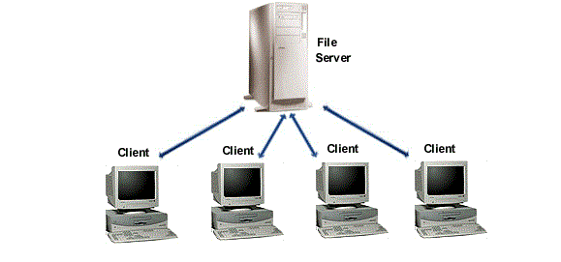
client and server network
This is type of network in which there is a server that is attached to client computer. So one computer is behaving as a center server controlling and managing other computers.

Slide 10
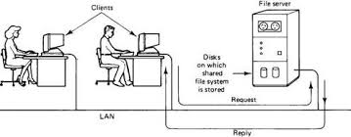
Distributed operating System
Distributed systems use multiple central processors to serve multiple real-time applications and multiple users.
The processors communicate with one another through various communication lines (such as high-speed buses or telephone lines). These are referred as loosely coupled systems or distributed systems.

Slide 11
REAL time operating system
A real-time operating system is a multitasking operating system designed for real-time applications. Such applications include embedded systems, industrial robots, scientific research equipment and others.
Advantages of real-time operating system :
Maximum Consumption of the system
Task Shifting
Focus on Application

Slide 12
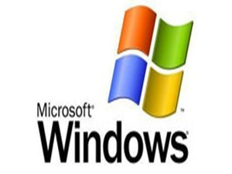
What is windows os?
Windows OS, computer operating system(OS) developed by Microsoft Corporation to run Personal Computers (PCs).
Approximately 90 percent of PCs run some version of Windows.
The most widely used operating system for desktop and laptop computers.
Windows makes it possible to complete all types of everyday tasks on your computer. For example, you can use Windows to browse the Internet, check your email, edit digital photos, listen to music, play games, and do much more.

Slide 13
Advantages & Disadvantages of Windows os
Advantages :
Windows provides ready-made solutions that can be implemented by just about anyone who’s ever used a computer , Because of the large amount of Microsoft Windows users , there is a much larger selection of available software programs ,utilities , and games for Windows .
Microsoft has implemented many changes throughout its versions of Windows to facilitate ease of use

Slide 14
Microsoft Windows has a very large user base , so , Most hardware manufacturer support Windows drivers for their products , And the majority of Windows programs are not open source .
Microsoft has made great security improvements to their operating system over the years , Windows continues to be the most vulnerable to the viruses , the malware , and other attacks .

Slide 15
Disadvantages:
Microsoft Windows has poor support for older hardware , Legacy support for older hardware is gone in Windows 2000 and Windows Xp , Microsoft claims this that was necessary to increase the overall stability of their systems .
Microsoft Windows uses high resource requirements , As opposed to the makers of other operating systems , Microsoft requires its customers to invest the most in their computer hardware , a faster processor ( CPU ) , more internal memory and a larger hard disk .

Slide 16
Workstation & Server

Slide 17
Difference Between Windows Workstation and Server
 | Server | Workstation
Definition | A server is an application or device that performs service for connected clients as part of client server architecture. | A computer that is used to power applications such as graphic art, 3-D design, Video Editing, or other CPU/RAM intensive software
Function | Internet, Office, Education, Home Networks | Business, Design, Engineering, Multi-Media Production
Operating systems | Free BSD, Solaris, Linux, Windows server | Unix, Linux, Windows workstation

Slide 18
 | Server | Workstation
GUI | Optional | Installed
Examples | Web servers, application servers etc. | Video and audio workstation.
Application | Hosting, Intranet | Professional
Reliability | Often comes with error correcting DDR modules, storage disks are typically in RAID and often have more than one power supply unit along with more than one Network port. Can be run in multiple-CPU setups. | No error correcting DDR modules, RAID Storage Disks aren't typically used. Only one power supply unit and very often only one network port.

Slide 19
Versions of Workstation & Server os
Server OS - It is designed to run on servers that operate within a client or server architecture to serve the requests of client computers on network.
Client OS – It is designed to run on system that works within computer desktops and various portable devices. This is different from centralized servers because it only supports a single user.

Slide 20
OS(Client) | Ver. | OS(Server) | Ver.
Win 10 | 10.0 | Win Server 2016 | 10.0
Win 8.1 | 6.3 | Win Server 2012 R2 | 6.3
Win 8 | 6.2 | Win Server 2012 | 6.2
Win 7 | 6.1 | Win Server 2008 R2 | 6.1
Win Vista | 6.0 | Win Server 2008 | 6.0
Win XP 64-Bit Edition | 5.2 | Win Server 2003/ 2003 R2 | 5.2
Win XP | 5.1 | Win Server 2000 | 5.0

Slide 21
Requirements needed to install windows os
Processor: 1 gigahertz (GHz) or faster
RAM: 1 gigabyte (GB) (32-bit) or 2 GB (64-bit)
Free hard disk space: 16 GB
Graphics card: Microsoft DirectX 9 graphics device with WDDM driver
A Microsoft account and Internet access

Slide 22
WINDOWS KERNEL

Slide 23
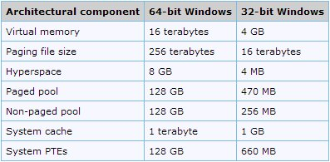
Diff between windows 32 and 64 bit architecture

Slide 24

32 bit v/s 64 bit
Addresses
RAM per operating system
RAM per process
Wider programs available
Faster
Exclusive programs available

Slide 25
Kernel
Kernel is the core or Heart of Operating System.
The kernel is a computer program that is the core of a computer’s operating system with complete control over everything in the system.
It is One of the first program loaded on start up

Slide 26
Kernel Architecture
ENVIRONMENT
SUBSYSTEM
LOGON PROCESS
Winlogon.exe
SECURITY
SUBSYSTEM
WIN32 application
Local Security Authority (LSA)
Security Accounts Manager (SAM)
USER MODE
WIN32 subsystem
I/O MANAGER
POWER MANAGER
PLUG N PLAY MANAGER
LOCAL PROCEDURAL CALL
KERNEL TRANS-
ACTION MANAGER
OBJECT
MANAGER
PROCESS & THREAD MANAGER
MEMORY
MANAGER
CONFIGUR-ATION MANAGER
(REGISTRY)
SECURITY REFERENCE MANAGER
KERNEL MODE
CACHE MANAGER
FILE SYSTEM
NETWORK DRIVERS
DEVICE DRIVERS
KERNEL
WINDOWS MANAGER
GDI
GRAPHICS DRIVERS
HARDWARE ASTRACTION LAYER
HARDWARE

Slide 27
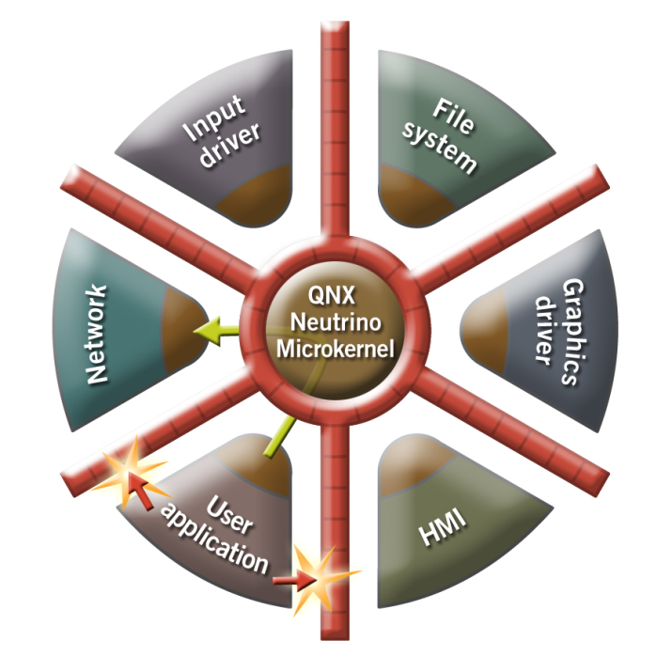
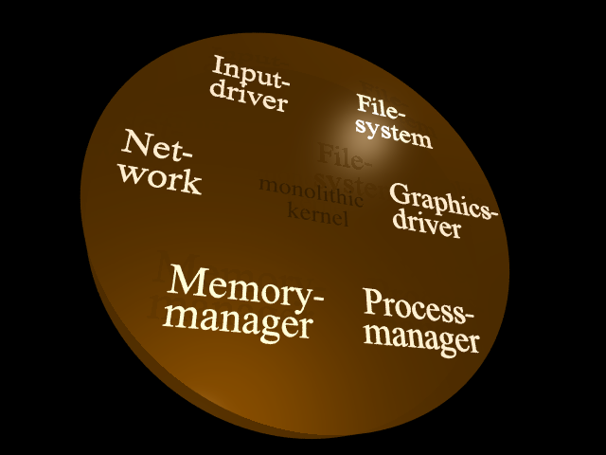
Types of Kernel
Monolithic kernel
Micro Kernel

Slide 28
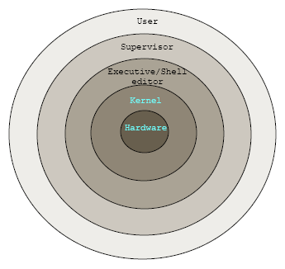
Hybrid Kernel

Slide 29
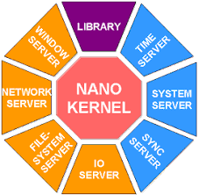
Nano Kernel
Nano was developed by ADEOS.
Widely using in Mobiles.

Slide 30
Sub system and types of subsystem
The interface between user mode applications and operatingsystem kernel functions is called an "environment subsystem."

Slide 31
Modes of kernel
User mode : In User mode, the executing code has no ability to directly access hardware or reference memory.
Kernel Mode: In Kernel mode, the executing code has complete and unrestricted access to the underlying hardware.

Slide 32
Executive services
HAL Hardware Abstraction Layer (HAL) provides function API-based service to the higher-level layers (ex: Application Framework, customer application, Et cetera) that allows them to perform hardwareoriented operations independent of actual hardware details

Slide 33
Executive services
I/O Manager
Object Manager
Process and Thread Manager
Memory Manager
Security And Reference Manager
Configuration Manager Registry

Slide 34
Executive services
I/O MANAGER
The Windows kernel-mode I/O manager manages the communication between applications and the interfaces provided by device drivers.
The communication between the operating system and device drivers is primarily done through I/O request packets (IRPs).
They are passed from operating system to specific drivers and from one driver to another.

Slide 35
Executive services
I/O MANAGER COMPONENTS:
The I/O manager has two subcomponents:
1.Plug and Play manager
2.Power manager.

Slide 36
Executive services
OBJECT MANAGER:
An object is a collection of data that the operating system manages.
The Windows kernel-mode object manager component manages objects.
Ex: Files,devices,registry keys, and so on.
Windows has more than 25 types of objects.
keeps track of the objects allocated to process.

Slide 37
Executive services
PROCESS AND THREAD MANAGER:
A process is a software program that is currently running in Windows.
A thread is an object that identifies which part of the program is running.
The Windows kernel-mode process and thread manager handles the execution of all threads in a process.

Slide 38
Executive services
Memory Manager :
The Windows kernel-mode memory manager component manages physical memory for the operating system. This memory is primarily in the form of random access memory (RAM).
The memory manager manages memory by performing the major tasks.
Managing the allocation and deallocation of memory virtually and dynamically.
Supporting the concepts of memory-mapped files, shared memory, and copy-on-write.

Slide 39
Executive services
SECURITY AND REFERENCE MANAGER :
An increasingly important aspect of operating systems is security. Before an action can take place, the operating system must be sure that the action is not a violation of system policy.
For example, a device may or may not be accessible to all requests
The Windows kernel-mode security reference monitor provides routines for your driver to work with access control.
Routines that provide a direct interface to the security reference monitor are prefixed with the letters "Se"; for example, SeAccessCheck.
Generally, higher-level drivers, particularly network drivers, call these routines.

Slide 40
Executive services
CONFIGURATION MANAGER REGISTRY :
In the earlier days of Microsoft Windows, applications and the operating system stored configuration values in "INI" (initialization) files.
The Windows Registry was created to store data about hardware and software.
The Windows kernel-mode configuration manager manages the registry.
Routines that provide a direct interface to the configuration manager are prefixed with the letters "Cm"; for example, ”CmRegisterCallback”.

Slide 41
Booting Process

Slide 42
Power-On Self Test (POST)
First step in the boot sequence for any computer with an operating system
Determines the amount of real memory, and whether or not all necessary hardware components are present
The actual tests can differ, depending on how the BIOS (Basic Input/Output System) is configured

Slide 43
Power-On Self Test (POST)
The software for the POST resides in a special, battery-powered chip called the CMOS (complimentary metal-oxide semiconductor)
This chip can store:
The software necessary to conduct the POST
Basic configuration information that the post uses to check the amount of RAM installed in a system

Slide 44
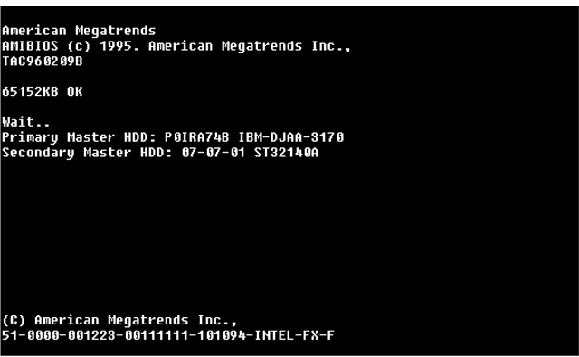
Power-On Self Test (POST)
Figure 13-1: The POST display on a PC

Slide 45
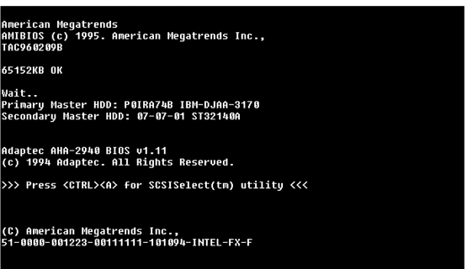
Power-On Self Test (POST)
Figure 13-2: Output from the BIOS on an Adaptec 2940 SCSI controller

Slide 46
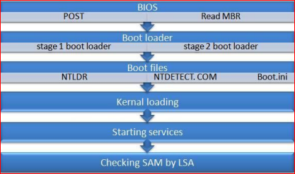
Pre Boot Sequence

Slide 48
Boot Loader
Boot loader processing and files:
Select an operating system to boot
Load the related operating system files from the boot partition

Slide 49
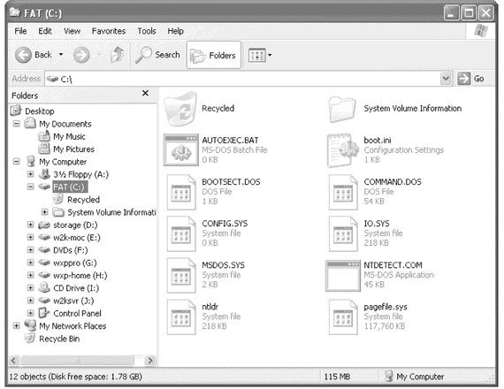
Boot Loader
Figure 13-3: The system partition on a typical Windows XP system

Slide 50
Boot Loader
Boot selection menu
Represents the point at which users can select which operating system they would like to load
Also called the boot loader screen

Slide 51
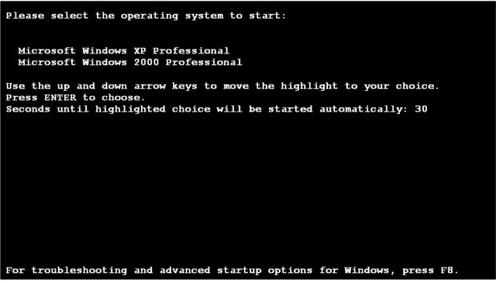
Boot Loader
Figure 13-4: A typical Windows XP boot selection menu

Slide 52
Detecting Hardware
Ntdetect.com is executed by the boot loader and is used to collect a list of hardware currently installed in the computer
Once hardware is detected, the system needs to select a system configuration
Otherwise known as a hardware profile

Slide 53
Boot Configuration and Selecting an Operating System
The Windows XP boot configuration can be controlled through its configuration file, Boot.ini
This file consists of two sections:
[boot loader]
[operating systems]

Slide 54
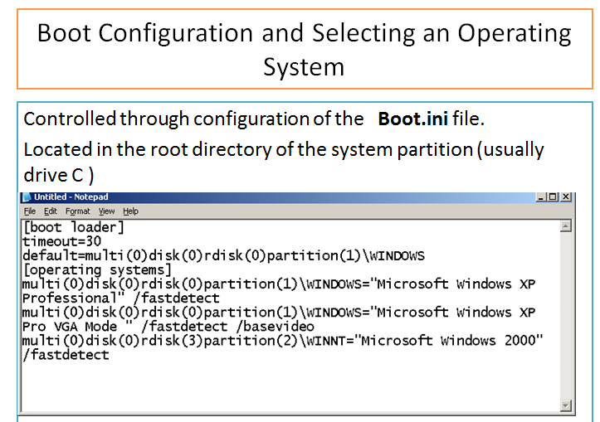
Figure 13-6: Boot.ini viewed through Notepad

Slide 55
Kernel load

